Slide 1
CSE 205
Digital Logic Design
Week 1
Dr. Mahmuda Naznin

Slide 2
CSE205 : Digital Logic Design
Instructor:
Mahmuda Naznin
Office hours: ECE 318, by appointment
Email: mahmudnaznin@cse.buet.ac.bd
Notice and resources will be at
http://cse.buet.ac.bd/moodle
Text: Digital Design
5th Edition by Morris Mano, Michael D. Ciletti , Pearson Print

Slide 3
Course Structure and Grading Policy
Lectures: Mostly follow textbook.
Class Participation:10%
Class Tests: 20%, Any 3 out of 4

Slide 4
This Lecture
Digital Design?
Binary Systems

Slide 5
Binary storage & registers
How do we store binary information?
Binary cell : place to store one bit of information. 0 or 1.
Register: a group of binary cells.
Register transfer: An operation in a digital system

Slide 6
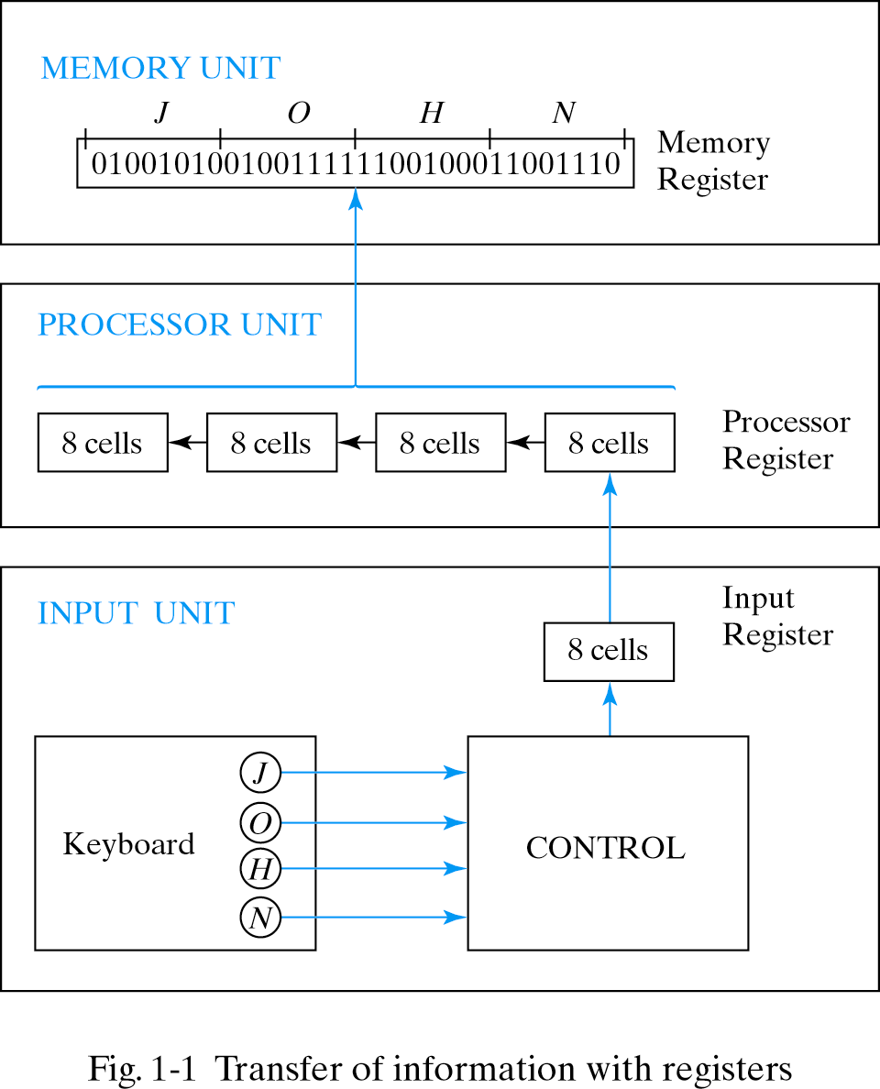
Binary storage & registers

Slide 7
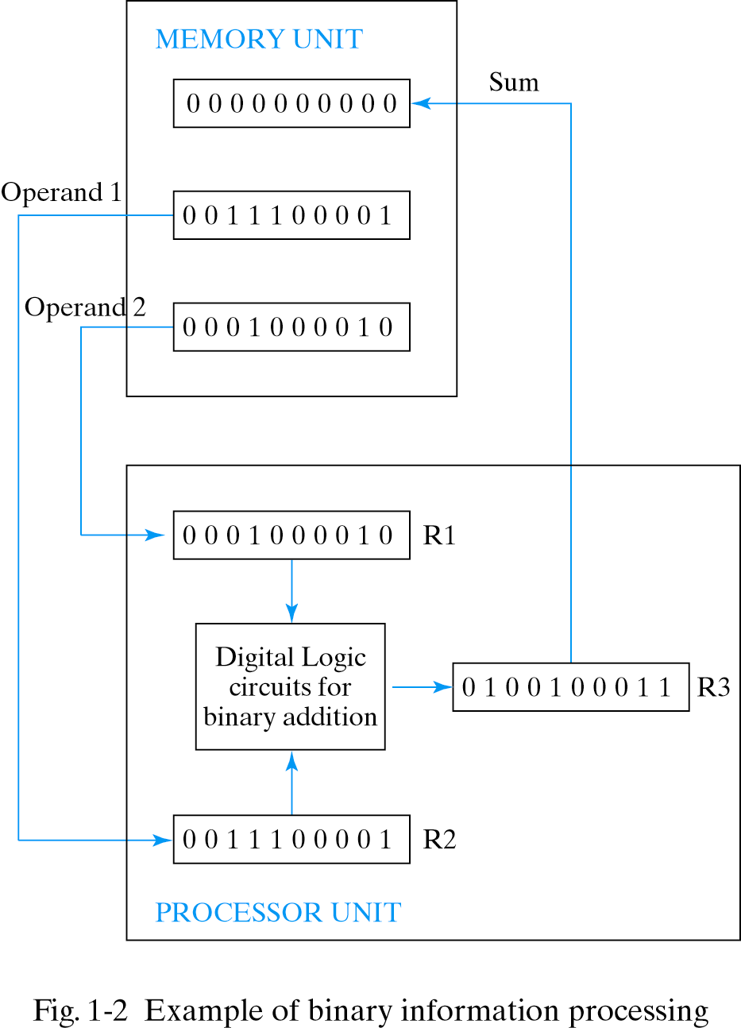
Binary information processing
Example: Add two 10-bit binary numbers

Slide 8
Binary logic
Binary logic deals with variables that take on two discrete values and operations that assume logical meaning.
Logic gates: electronic circuits that operate on one or more input signals to produce an output signal.
Example
x y x AND y
0 0 0
0 1 0
1 0 0
1 1 1

Slide 9
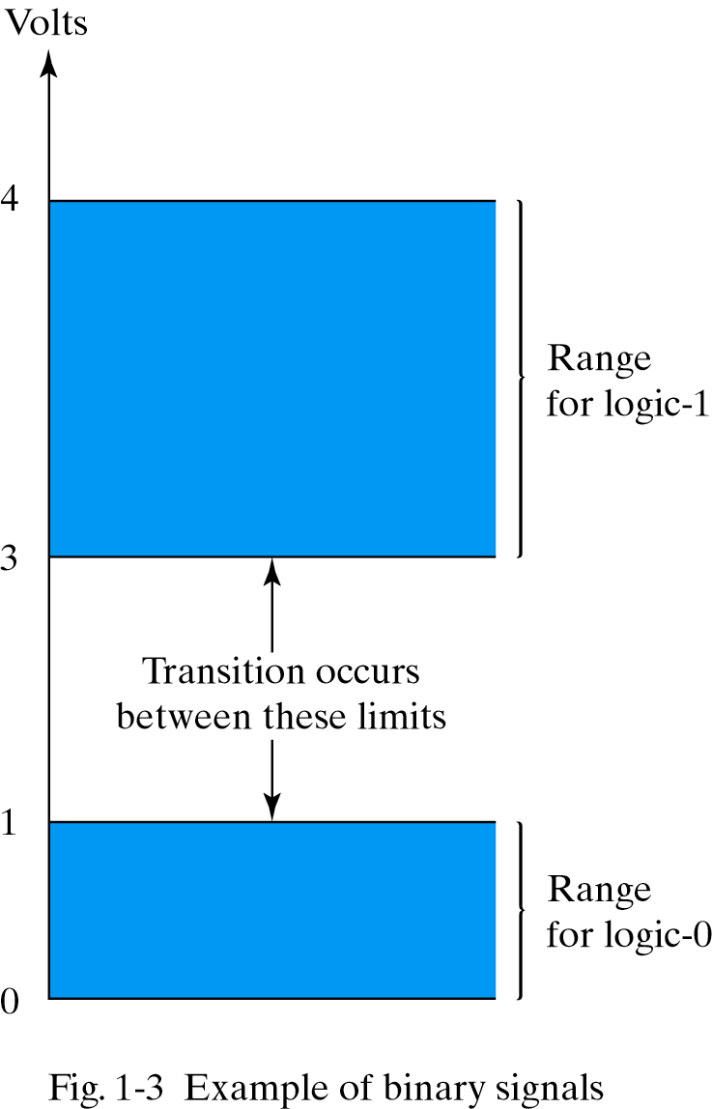
Electrical signals
Two values: 0 or 1

Slide 10
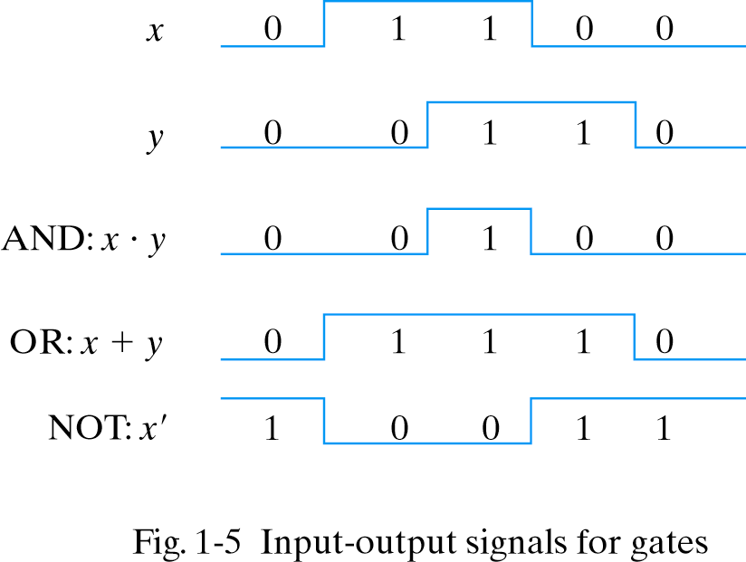
Input-Output signals for gates

Slide 11
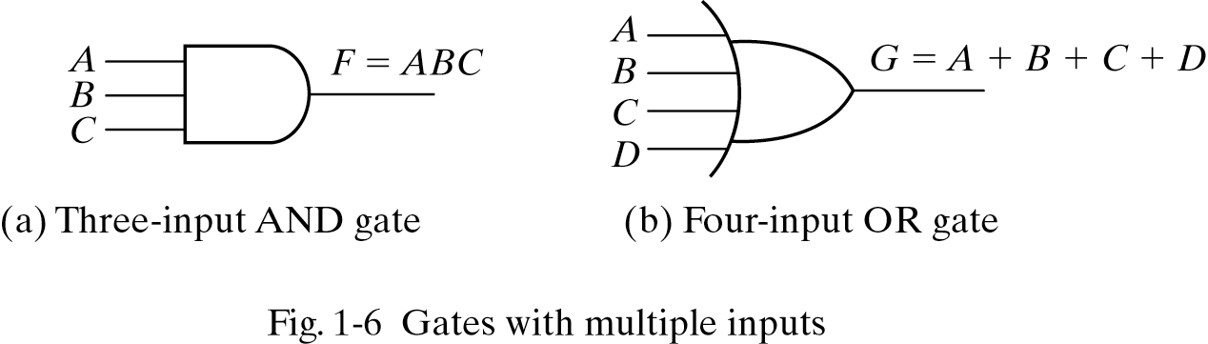
Gates with multiple inputs

Slide 12
Combinational Logic
a
b
a.b
a.b + c.d
e ( a.b.+.c.d )
c
d
c.d
e
Specification of input and output
Truth Table
Function Design
Implementation
Different Types of Gates

Slide 13
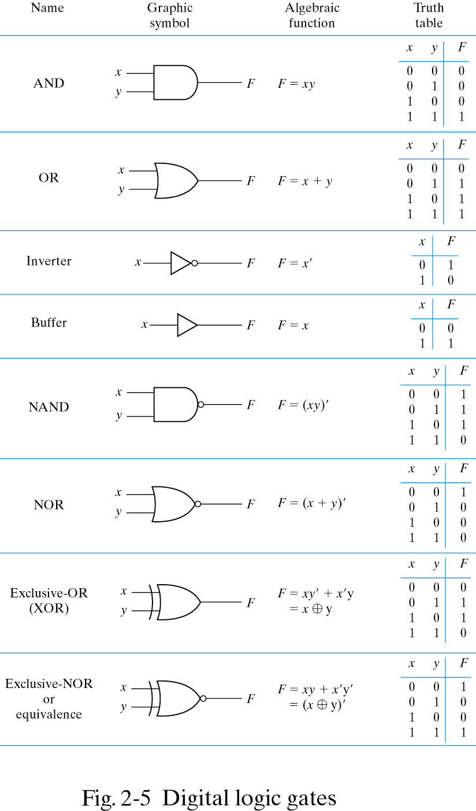
Logic Gates

Slide 14
Boolean Algebra
x+0=0+x=x [identity for OR]
x.1=1.x=x [identity for AND]
(x’) ’=x [Invoultion]
x+y=y+x, x.y=y.x [commutative]
x.(y+z)=(x.y)+(x.z) [distributive law, . over +]
x+(y.z)=(x+y).(x+z) [distributive law, + over .]

Slide 15
Boolean Algebra Theorems
x+x=x
x.x=x
x+1=1
x.0=0
x+x.y = x [Absorption]
x.(x+y) = x [Absorption]

Slide 16
Boolean Algebra Functions
Examples:
F1=x+y’.z
F2=x’.y’.z+x’.y.z+x.y’
=x’.z(y’+y)+x.y’
F2=x’.z+x.y’
We look for the most simple form
A Boolean Function can be represented in many algebraic forms

Slide 17
Boolean Function: Example
Truth table
x y z F1 F2
0 0 0 0 0
0 0 1 1 1
0 1 0 0 0
0 1 1 0 1
1 0 0 1 1
1 0 1 1 1
1 1 0 1 0
1 1 1 1 0
A Boolean Function can be represented in only one truth table forms

Slide 18
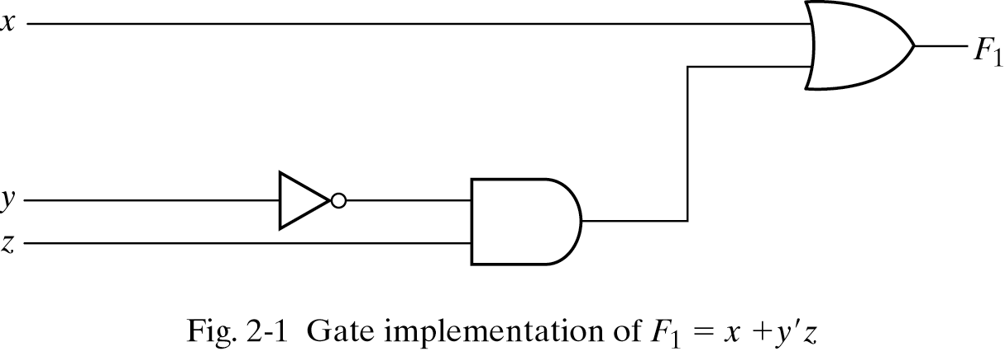
Boolean Function Implementation
y’
y’.z

Slide 19
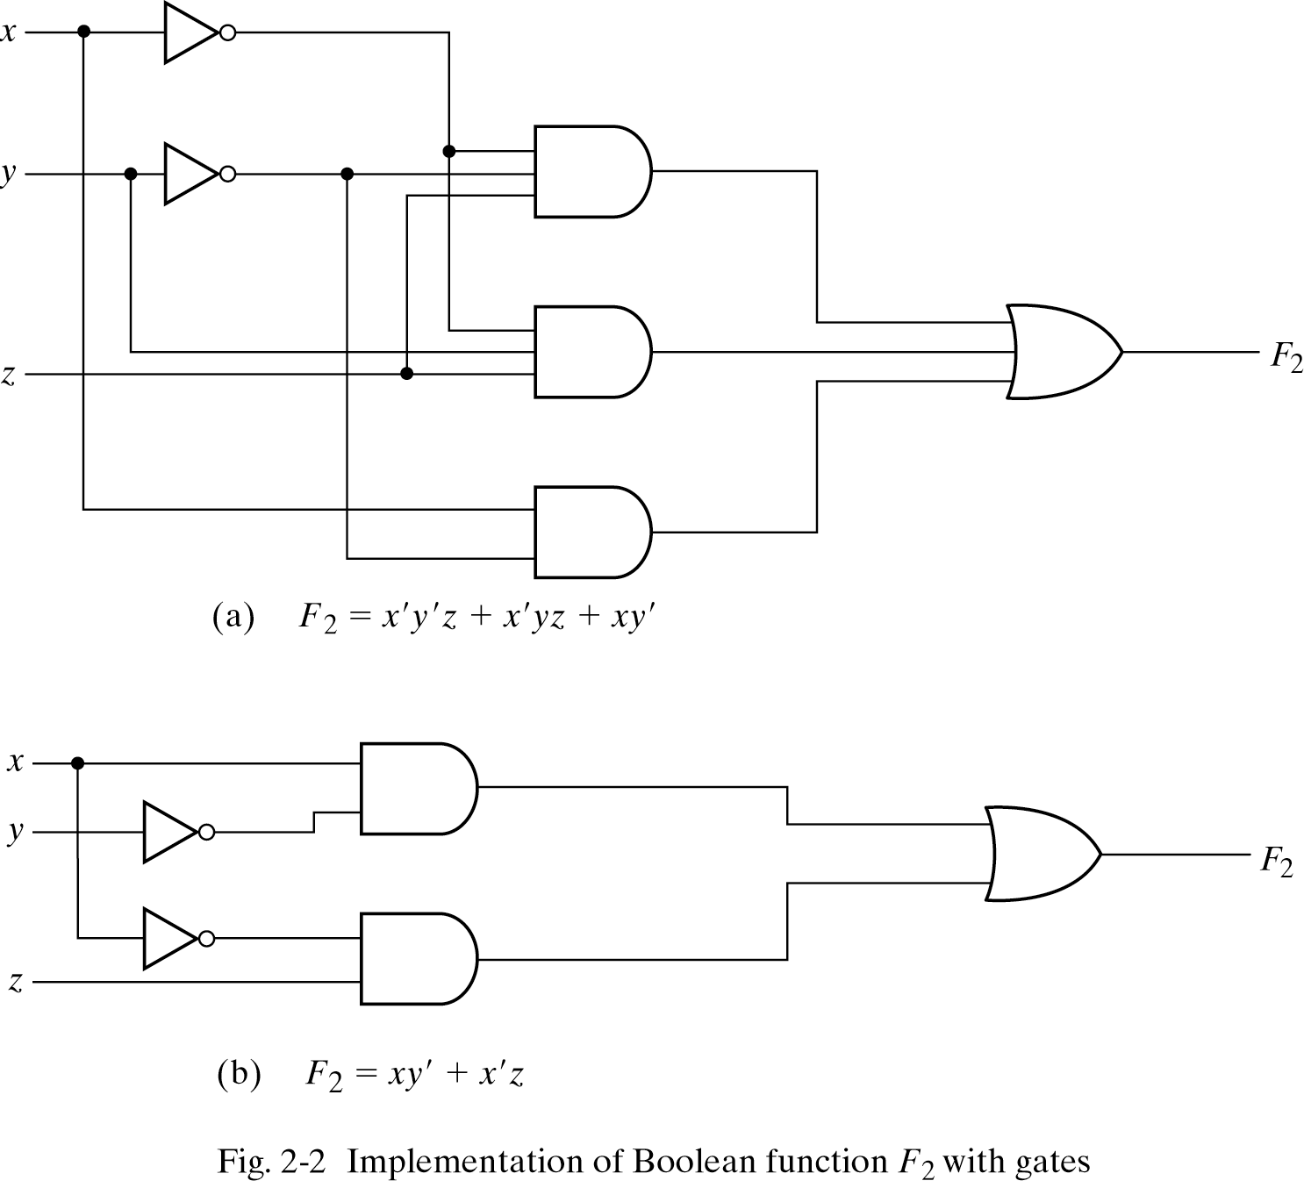
Boolean Function Implementation
X’.y’.z
X’.y.z
X.y’
X.y’
X’.z

Slide 20
Complement of a function
DeMorgan’s theorem:
(x+y)’=x’.y’
(x.y)’=x’+y’
What about three variables?
(x+y+z)’=?
Let A=x+y (A+z)’=A’.z’=(x+y)’.z’=x’.y’.z’
Let B=xy (B.z)’=B’+z’= x’+y’+z’

Slide 21
Canonical & Standard Forms
Consider two binary variables x, y and the AND operation
four combinations are possible: x.y, x’.y, x.y’, x’.y’
each AND term is called a minterm or standard products
for n variables we may have 2^{n} minterms
Consider two binary variables x, y and the OR operation
four combinations are possible: x+y, x’+y, x+y’, x’+y’
each OR term is called a maxterm or standard sums
for n variables we have 2^{n} maxterms
Canonical Forms:
Boolean functions are expressed as a sum of minterms or product of maxterms.

Slide 22
Minterms
x y z Terms Designation
0 0 0 x’.y’.z’ m0
0 0 1 x’.y’.z m1
0 1 0 x’.y.z’ m2
0 1 1 x’.y.z m3
1 0 0 x.y’.z’ m4
1 0 1 x.y’.z m5
1 1 0 x.y.z’ m6
1 1 1 x.y.z m7

Slide 23
Maxterms
x y z Designation Terms
0 0 0 M0 x+y+z
0 0 1 M1 x+y+z’
0 1 0 M2 x+y’+z
0 1 1 M3 x+y’+z’
1 0 0 M4 x’+y+z
1 0 1 M5 x’+y+z’
1 1 0 M6 x’+y’+z
1 1 1 M7 x’+y’+z’

Slide 24
Boolean Function: How to express algebraically? (Using Minterm)
Question: How do we find the function using the truth table?
Truth table example:
x y z F1 F2
0 0 0 0 0
0 0 1 1 1
0 1 0 0 0
0 1 1 0 1
1 0 0 1 1
1 0 1 1 1
1 1 0 1 0
1 1 1 1 0

Slide 25
Boolean Function: How to express algebraically ??
1. Form a minterm for each combination forming a 1
2. OR all of those terms
Truth table example:
x y z F1 minterm
0 0 0 0
0 0 1 1 x’.y’.z m1
0 1 0 0
0 1 1 0
1 0 0 1 x.y’.z’ m4
1 0 1 0
1 1 0 0
1 1 1 1 x.y.z m7
F1=m1+m4+m7= x’.y’.z+x.y’.z’+x.y.z = Σ(1,4,7)

Slide 26
Boolean Function: How to express algebraically ??
Truth table example:
x y z F2 minterm
0 0 0 0 m0
0 0 1 0 m1
0 1 0 0 m2
0 1 1 1 m3
1 0 0 0 m4
1 0 1 1 m5
1 1 0 1 m6
1 1 1 1 m7
F2=m3+m5+m6+m7 = x’.y.z+x.y’.z+x.y.z’+x.y.z = Σ(3,5,6,7)

Slide 27
Boolean Function: How to express algebraically (Using Maxterm)
1. Form a maxterm for each combination forming a 0
2. AND all of those terms
Truth table example:
x y z F1 maxterm
0 0 0 0 x+y+z M0
0 0 1 1
0 1 0 0 x+y’+z M2
0 1 1 0 x+y’+z’ M3
1 0 0 1
1 0 1 0 x’+y+z’ M5
1 1 0 0 x’+y’+z M6
1 1 1 1
F1=M0.M2.M3.M5.M6 = л(0,2,3,5,6)

Slide 28
Boolean Function: How to express algebraically
Truth table example:
x y z F2 maxterm
0 0 0 0 x+y+z M0
0 0 1 0 x+y+z’ M1
0 1 0 0 x+y’+z M2
0 1 1 1
1 0 0 0 x’+y+z M4
1 0 1 1
1 1 0 1
1 1 1 1
F=M0.M1.M2.M4=л(0,1,2,4)=(x+y+z).(x+y+z’).(x+y’+z).(x’+y+z)

Slide 29
Maxterms & Minterms: Intuitions
Minterms:
If a function is expressed as SUM of PRODUCTS, then if a single product is 1 the function would be 1.
Maxterms:
If a function is expressed as PRODUCT of SUMS, then if a single product is 0 the function would be 0.
Canonical Forms:
Boolean functions expressed as a sum of minterms or product of maxterms.

Slide 30
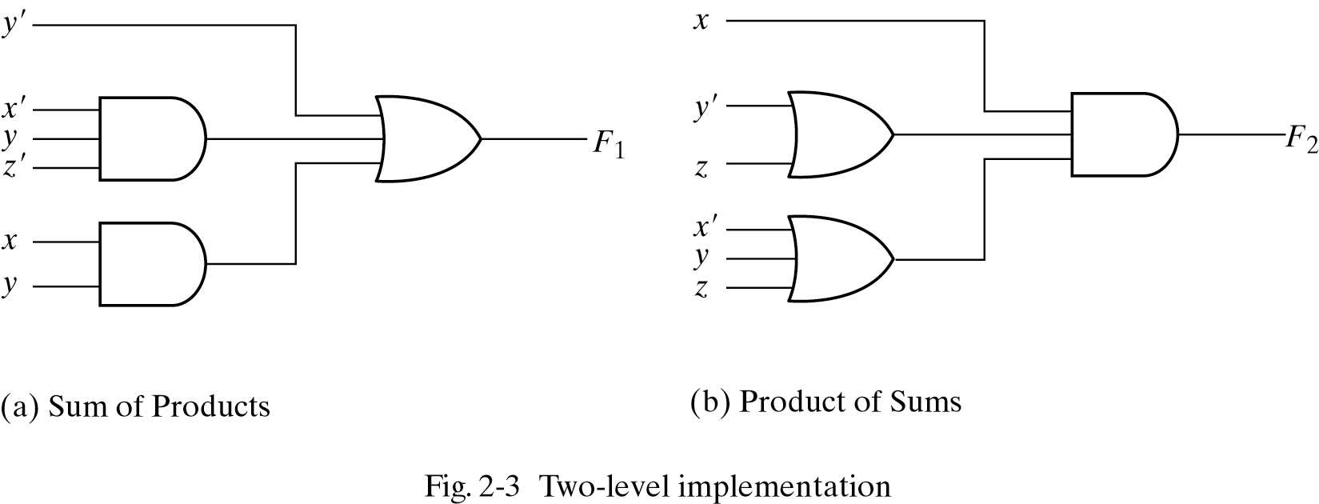
Standard Forms
Standard From: Sum of Product or Product of Sum

Slide 31
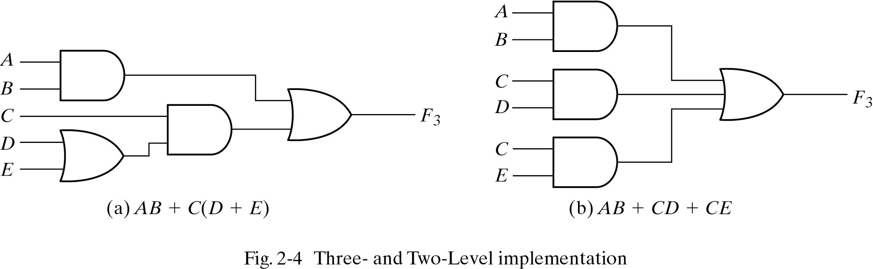
Nonstandard Forms
Nonstandard From: Neither a Sum of Product nor Product of Sum

Slide 32
Implementations
Three-level implementation vs. two-level implementation
Two-level implementation normally preferred due to delay importance.

